Slide 1

SMARTFARM HUB
Presented by :
Yashvitha K N

Slide 2
CONTENTS
Abstract
Existing System
Proposed System
DFD Diagram
Module Description
Snapshots
Future Enhancement
Conclusion

Slide 3
Abstract
The main purpose of this project is to enhance agriculture management by providing online access information about soil, fertilizers and products. It enables farmers to sell products directly to customers. The system is designed to meet diverse user needs by offering detailed and updatable information on soil and fertilizers. This application aims to provide better quality, price and accessibility for all agricultural stakeholders.

Slide 4
EXISTING SYSTEM
In the existing system buying and selling a product, price of the product is fixed by the seller. All the details of the product to be sold or purchase is maintained manually. Sellers or buyers not able to get the complete information about the product. The “SmartFarm Hub” has been developed to override the problems prevailing in the practicing manual system. This software is supported to eliminate and in some cases reduce the hardships faced by this existing system.

Slide 5
PROPOSED SYSTEM
The “SmartFarm Hub” has been developed to override the problems prevailing in the practicing manual system. This software is supported to eliminated and in some cases reduce the hardship faced by this existing system. Every organization, whether big or small, has challenges to overcome and managing the information of soil, fertilizer and product. The proposed system buyers or sellers can directly register in the site and sell/buy the product otherwise they can contact with a seller directly. Buyers can open the site and register with it and sell their products online.

Slide 6

DATA
FLOW
DIAGRAM

Slide 7
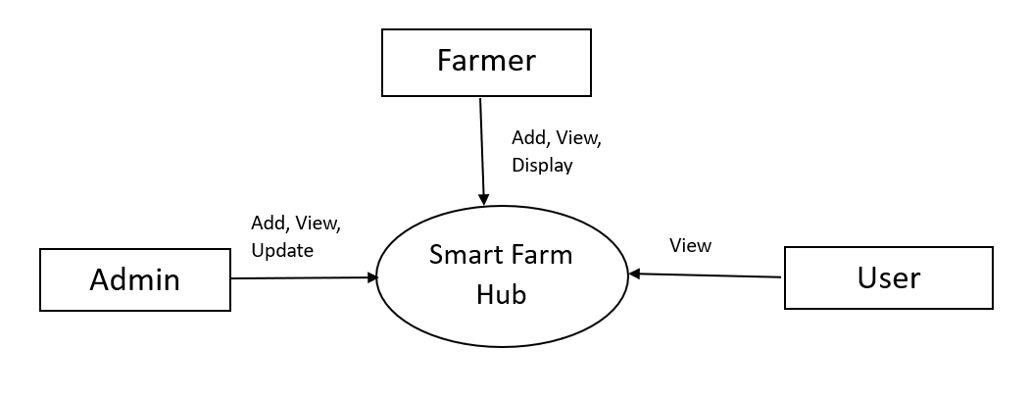
LEVEL 0 DFD

Slide 8
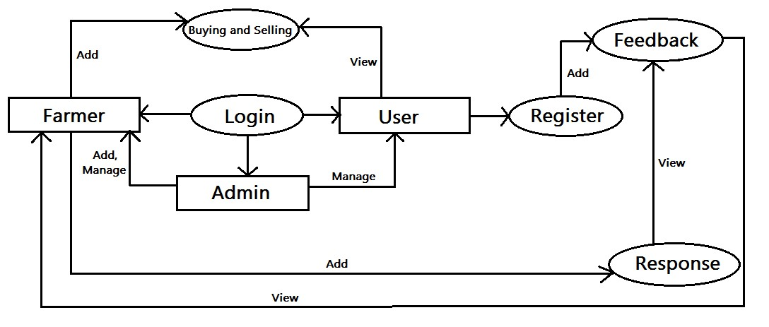
LEVEL 1 DFD

Slide 9
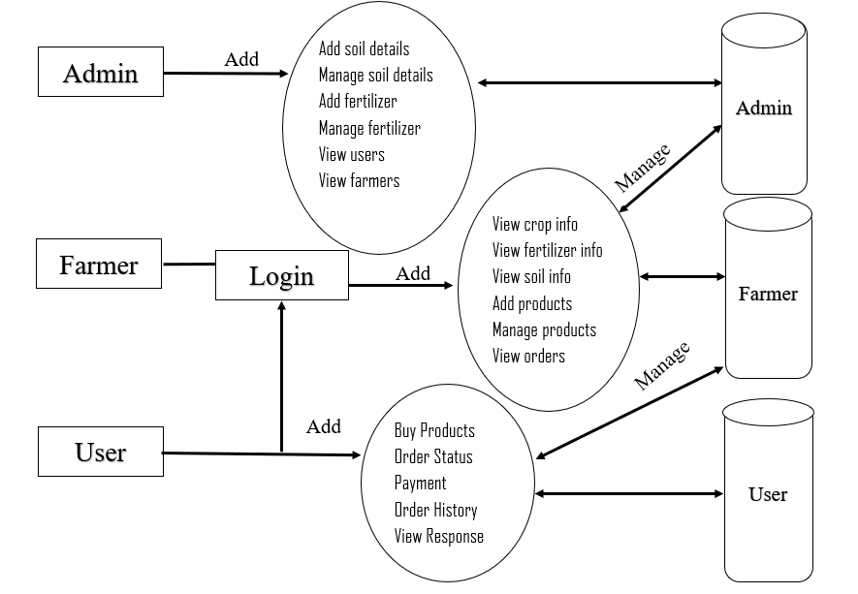
LEVEL 2 DFD

Slide 10
MODULE DESCRIPTION
Admin
1. Admin Dashboard
A panel shows key metrics—soil records, fertilizer records.
2. Add/Mange Soil Details
CRUD views using model like soil model.
Template-driven forms for entry and updating, list views for overview.
3. Add/Manage Fertilizer Info
Similar CRUD setup for Fertilizer model: fields like name, about, image.

Slide 11
Farmer
1. Farmer Dashboard
Farmer-specific metrics views the soil and fertilizer.
Add products and view the orders and payment.
2. View Soil & Fertilizer Info
Read‑only lists of soil and fertilizer records, by the data given by admin.
3. Add/Manage Products
CRUD forms and views for products that farmers sell—fields like product name, description, price and image.

Slide 12
v
4. View Payment & Orders
Read-only views showing payment history and order details by user.
5. Send Response & View Feedback
Possibly a messaging or response feature, allowing farmers to reply to queries from customers about soil, fertilizer or product, or send response to user feedback.

Slide 13
User
1. User Dashboard
Overview of user-specific details of orders, past purchases, recommended system and payment.
2. Buy Products & Payment
Product listing pages with “Add to Cart”, followed by a checkout process integrating payment logic.
3. Order Status & Order History
Views showing user’s current order status and historical purchases.

Slide 14
4. Recommend System
The system recommends suitable fertilizers based on soil type and region.
Uses machine learning to provide intelligent suggestions.
5. Send Feedback & View Response
Forms where users can submit feedback paired with a view area to see farmer responses.

Slide 15
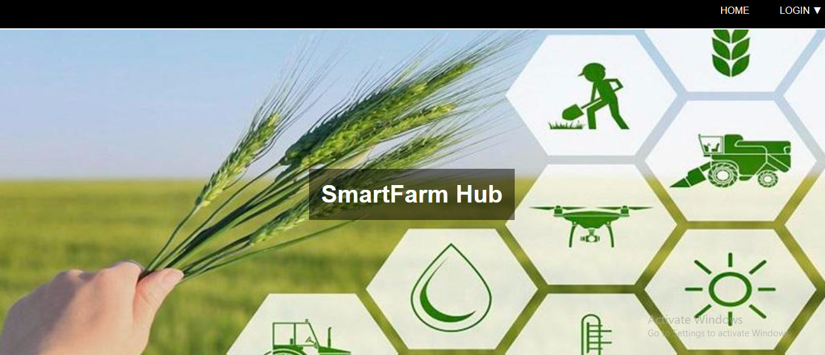
SNAPSHOTS

Slide 16
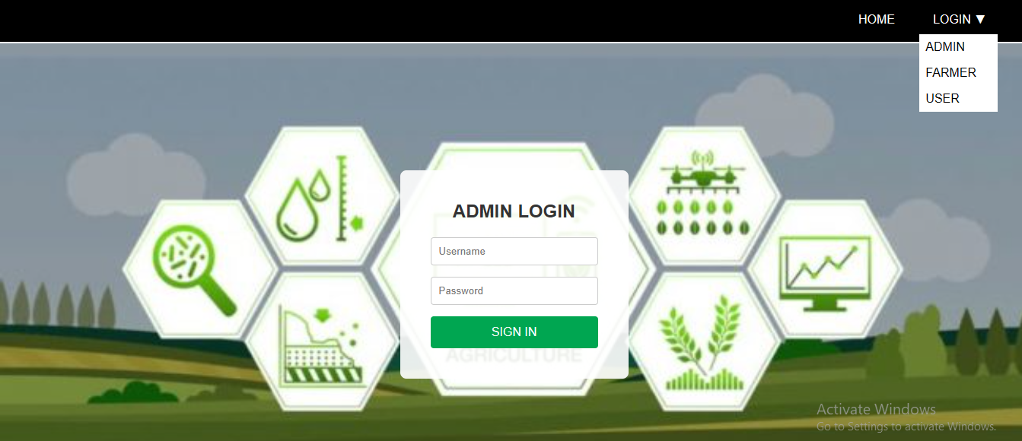

Slide 17
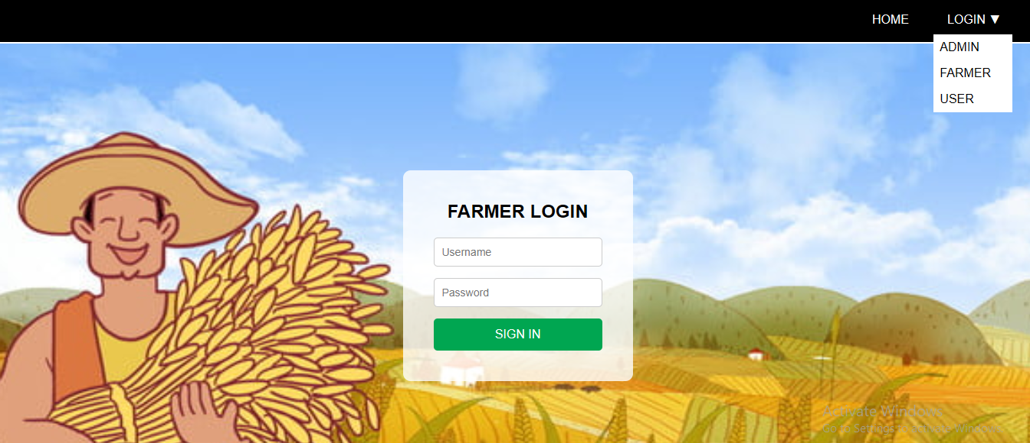

Slide 18
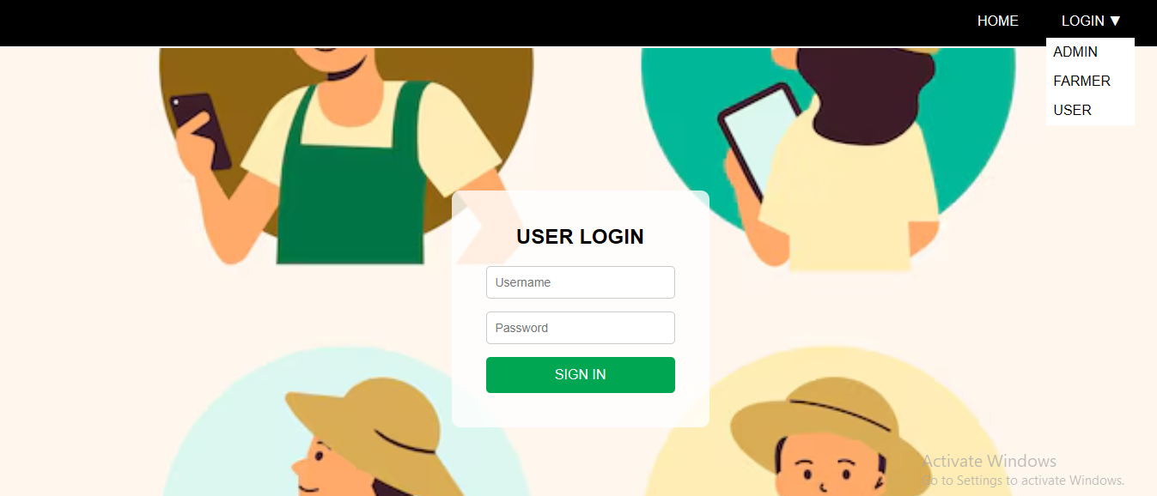

Slide 19
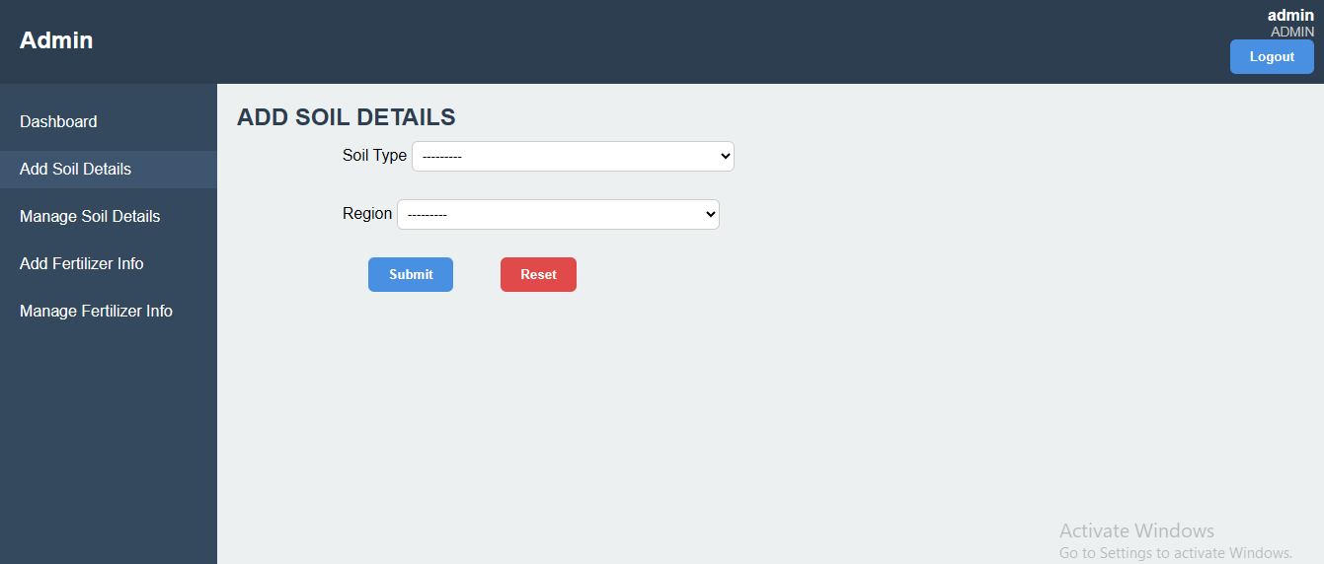

Slide 20
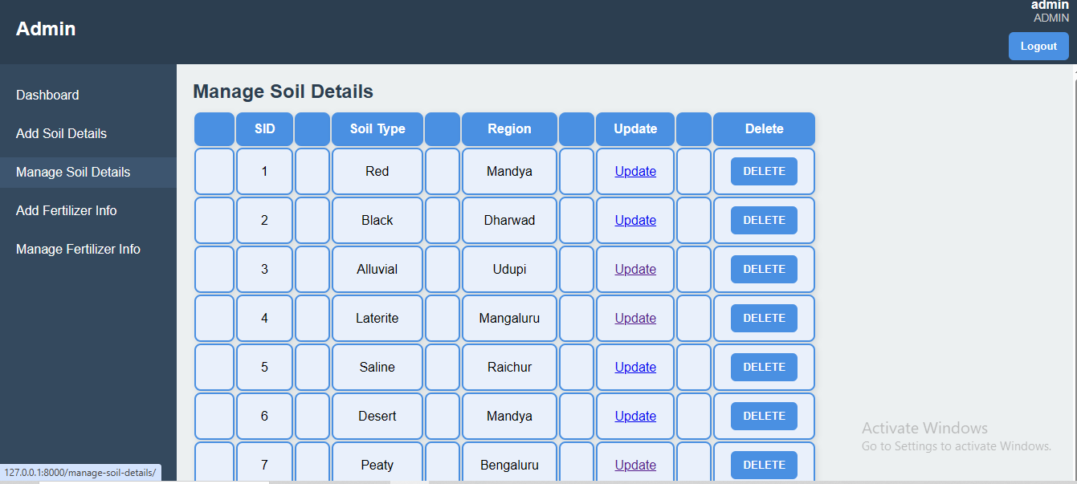

Slide 21
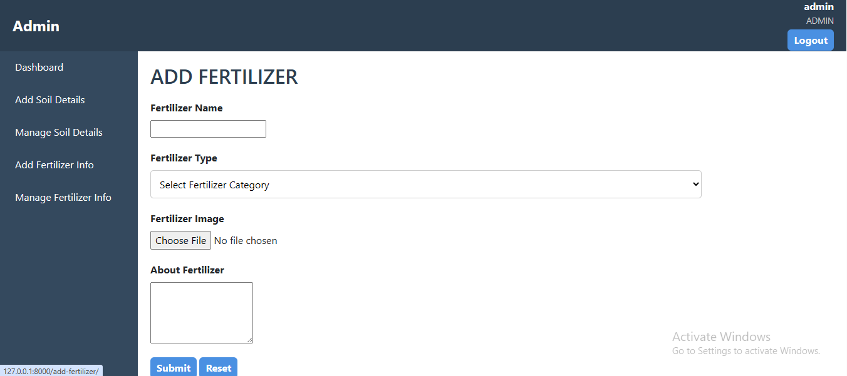

Slide 22
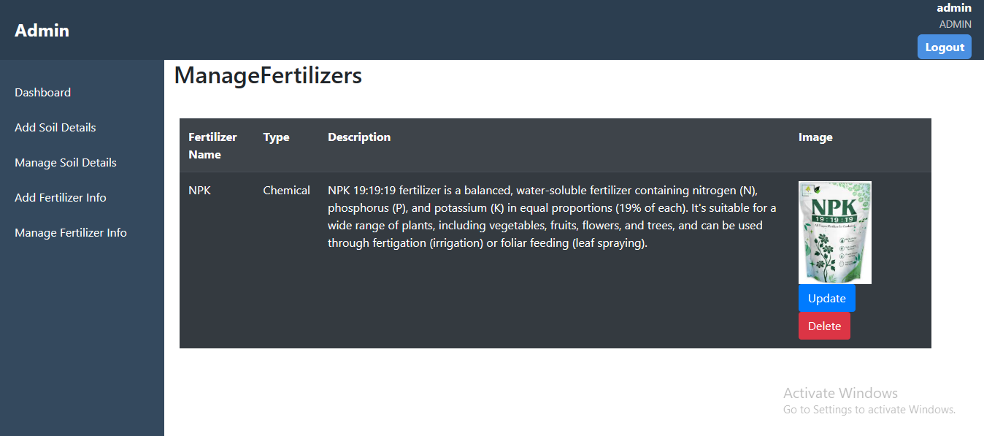

Slide 23
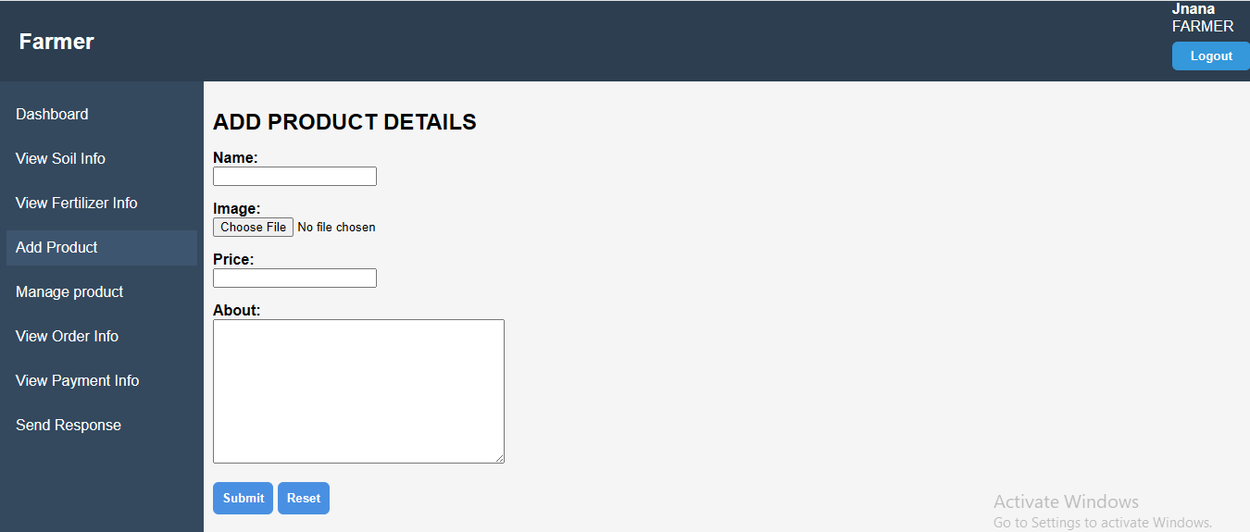

Slide 24
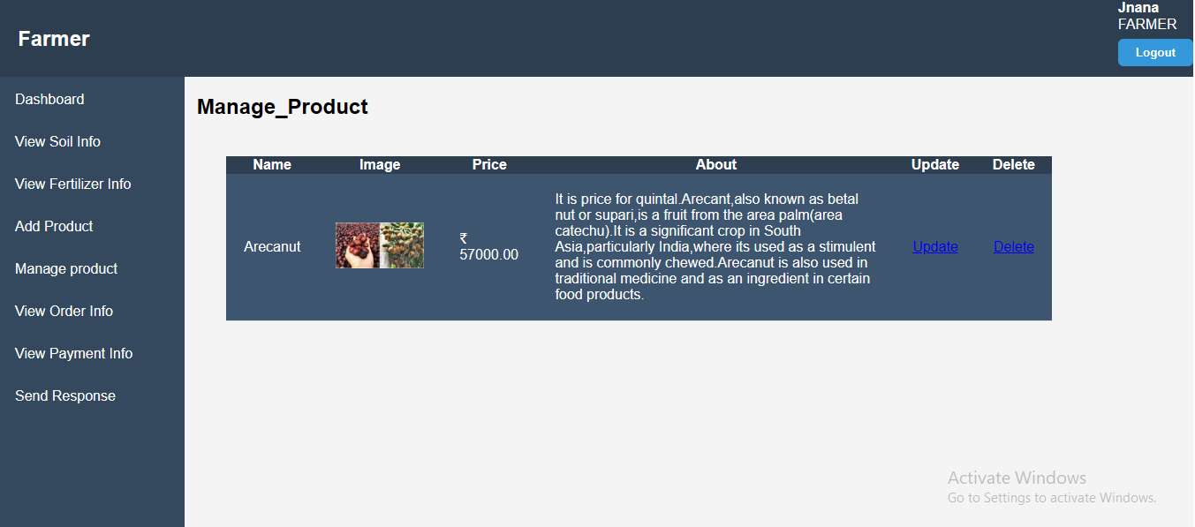

Slide 25
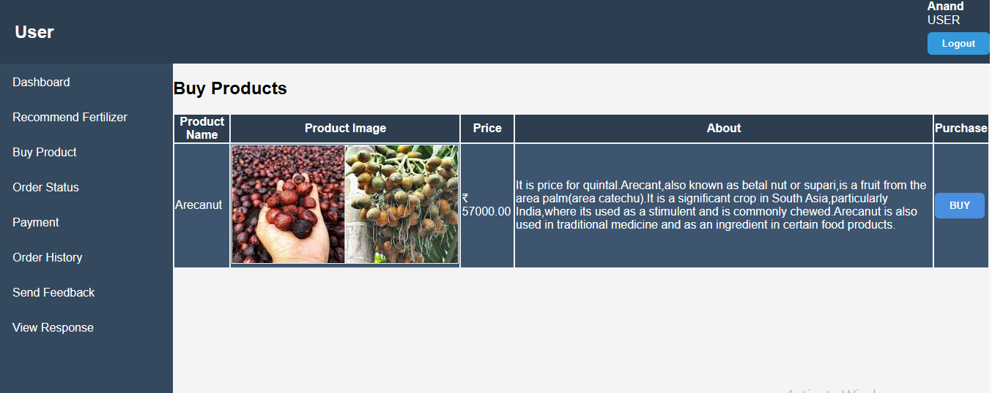

Slide 26
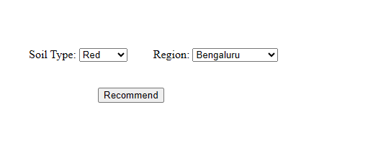
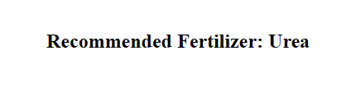

Slide 27
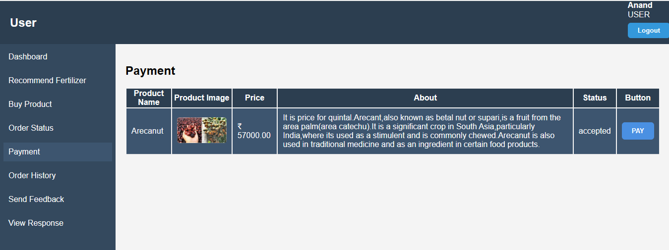

Slide 28
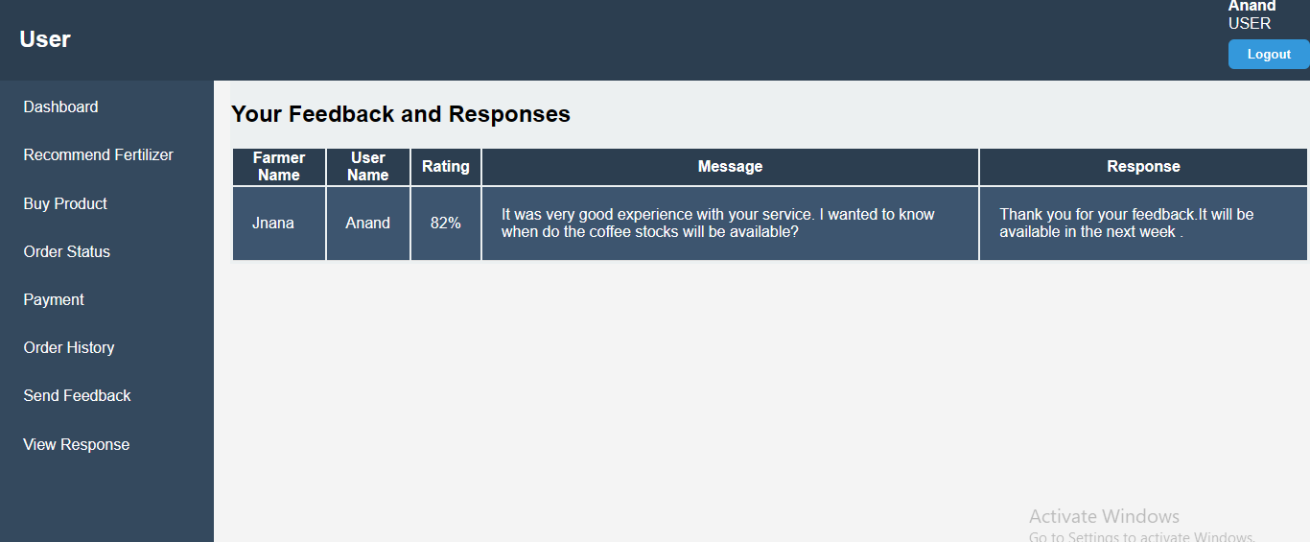

Slide 29
Future Enhancement
The method of video conferencing can be added to make the project livelier.
In future work we will implement QR code scan for the better payment process by user.
In future system will provide mail and direct contact to admin. Admin can send mail to other farmer and user.
In future we provide notification alert for customer availability of products hence customer can buy products early.

Slide 30
Integration with Real-time Sensor Data by incorporating IoT-based soil sensors can automate the collection of real-time data on moisture, pH, and temperature, allowing the model to make even more accurate and dynamic recommendations.
Crop-specific Recommendation System by expanding the system to include crop-specific fertilizer plans based on growth stage, nutrient uptake rate, and historical yield data for better precision.
AI Chatbot Assistance by introducing a chatbot to assist users in understanding recommendations, resolving doubts, and guiding them through the usage of the platform.
Integration with Government and Agricultural Databases like linking the system with regional agricultural databases can enrich the model with verified, large-scale data and keep it updated with new fertilizer formulations and usage regulations.

Slide 31
CONCLUSION
Our project has been successfully implemented the idea of online business. Buyers and Sellers can purchase products from any farmer. Our project helps buyers and sellers in saving a lot of time and money. It provides various information required for farmers and users and it also provides solution to the users queries posted. This makes agriculture more eco-friendly and this portal is very useful to all kinds of users who don’t have much idea about agriculture. This project gave us the idea about, how large data are stored inside a database and organized so that it can be retrieved easily and in a more efficient way. This application will be widely used in future by farmers, common peoples, agriculture students and even agriculture officers.

Slide 32
In this project, we successfully implemented a Machine Learning-based recommendation system to optimize fertilizer selection for users. By analyzing manually entered data such as soil type, region, the system intelligently suggests the most suitable fertilizer. This integration of ML as the business logic enables the application to go beyond static recommendations, providing personalized, data-driven suggestions that can significantly enhance crop yield and soil health.
The ML model, trained on relevant agricultural datasets, has been integrated into the Django framework, allowing for real-time and scalable recommendations. As a result, users receive actionable insights, reducing their dependency on manual expertise and minimizing errors in fertilizer usage. This approach not only supports sustainable farming practices but also improves overall productivity and decision-making efficiency.

Slide 33
THANK YOU

